Slide 1
Credit Card Fraud Detection
Prepared by : Parita Chodvadiya
External Guide: Mr. Sahaj Godhani

Slide 2
Introduction
Credit card fraud is a significant problem, with billions of dollars lost each year. Machine learning can be used to detect credit card fraud by identifying patterns that are indicative of fraudulent transactions. Credit card fraud refers to the physical loss of a credit card or the loss of sensitive credit card information. Many machinelearning algorithms can be used for detection. This project proposes to develop a machine-learning model to detect credit card fraud. The model will be trained on a dataset of historical credit card transactions and evaluated on a holdout dataset of unseen transactions.

Slide 3
Overview
With the increase of people using credit cards in their daily lives, credit card companies should take special care of the security and safety of the customers. According to (Credit card statistics 2021), the number of people using credit cards worldwide was 2.8 billion in 2019; also, 70those users own a single card. Reports of Credit card fraud in the U.S. rose by 44.7in 2020. There are two kinds of credit card fraud, and the first is having a credit card account opened under your name by an identity thief. Reports of this fraudulent behaviour increased 48to 2020. The second type is when an identity thief uses an existing account you created, usually by stealing the information on the credit card. Reports on this type of Fraud increased 9to 2020(Daly, 2021). Those statistics caught We’s attention as the numbers have increased drastically and rapidly throughout the years, which motivated We to resolve the issue analytically by using different machine learning methods to detect fraudulent credit card transactions within numerous transactions.

Slide 4
Project Goals
The main aim of this project is the detection of fraudulent credit card transactions, as it is essential to figure out the fraudulent transactions so that customers do not get charged for the purchase of products that they did not buy. Fraudulent Credit card transactions will be detected with multiple ML techniques. Then, a comparison will be made between the outcomes and results of each method to find the best and most suited model for detecting fraudulent credit card transactions; graphs and numbers will also be provided. In addition, it explores previous literature and different techniques used to distinguish Fraud within a dataset.

Slide 5
Data Source
The dataset was retrieved from an open-source website, Kaggle.com. It contains data on transactions made in 2013 by European credit card users in two days only. Thedataset consists of 31 attributes and 284,808 rows. Twenty-eight attributes are numeric variables that, due to the confidentiality and privacy of the customers, have been transformed using PCA transformation; the three remaining attributes are ”Time”, which contains the elapsed seconds between the first and other transactions of each Attribute, ”Amount” is the amount of each transaction, and the final attribute “Class” which contains binary variableswhere “1” is a case of fraudulent transaction, and “0” is not as case of fraudulent transaction.

Slide 6
Tools and Technologies
Python Modules – Pandas, Numpy, Matplotlib, seaborn, Sklearn
ML Algorithm – Random Forest, Logistic Regression, SVM, DecisionTreeClassifier, Kneighbors Classifier and XGB Classifier
Tools – Google Colab, VS Code
Deployment - Streamlit

Slide 7
Implementation
Step 1 : Install Necessary Libraries
Step 2 : Import Libraries
Step 3 : Load and Preprocess Dataset
Step 4 : Filter and Handling Dataset
Step 5 : Train and Test Split
Step 6 : Model Building
Step : 7 Evaluate Model
Step : 8 Deployment

Slide 8
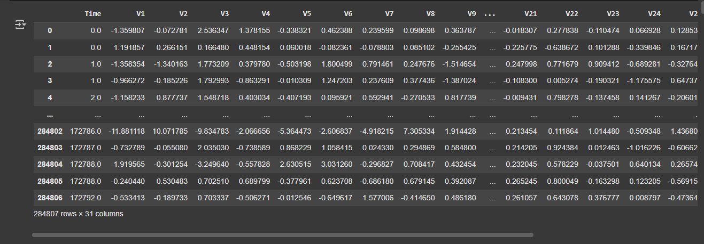
Load Dataset

Slide 9
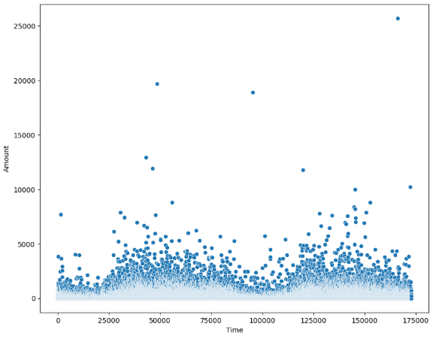
Filter and Handling Dataset with Visualization

Slide 10
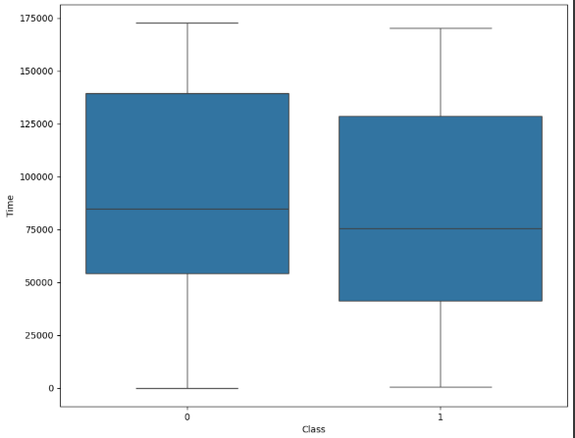

Slide 11
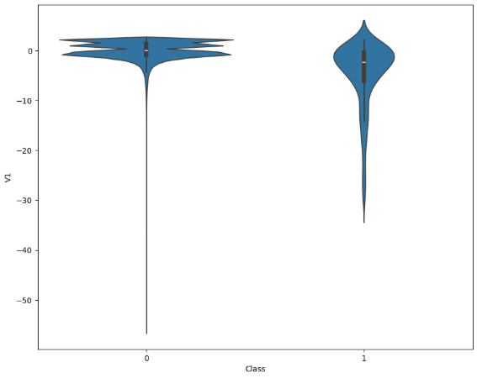

Slide 12
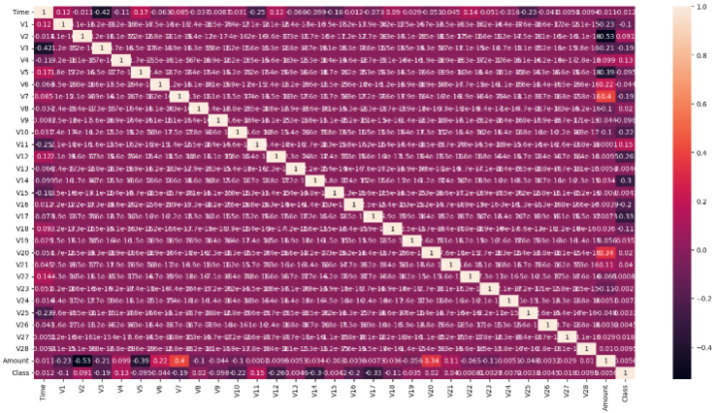

Slide 13
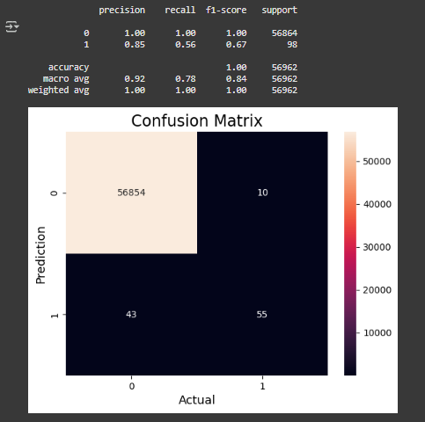
Logistic Regression

Slide 14
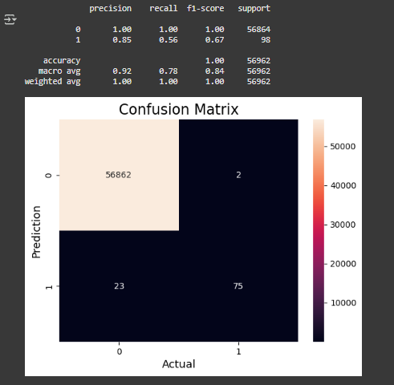
Random Forest

Slide 15
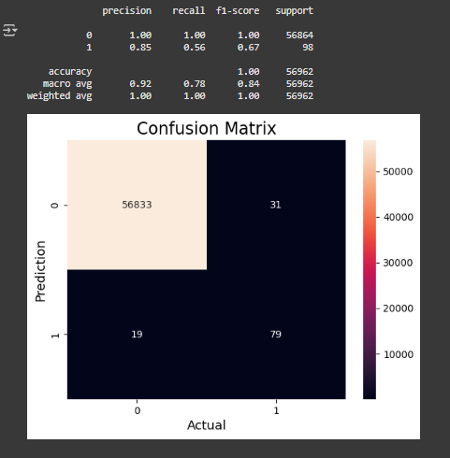
Decision Tree

Slide 16
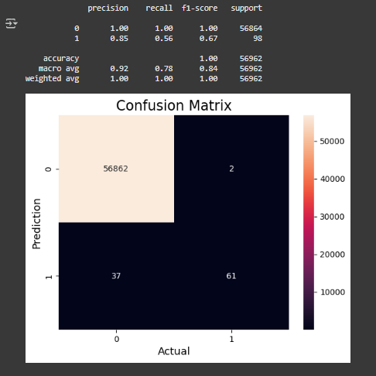
SVM(support vector machine)

Slide 17

KNN(KNeighborsclassifier)

Slide 18
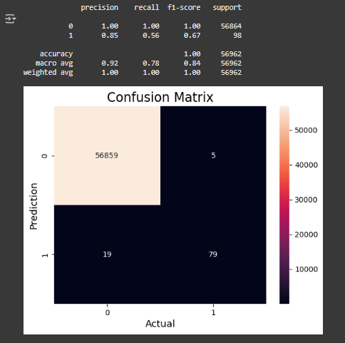
XGBoost

Slide 19
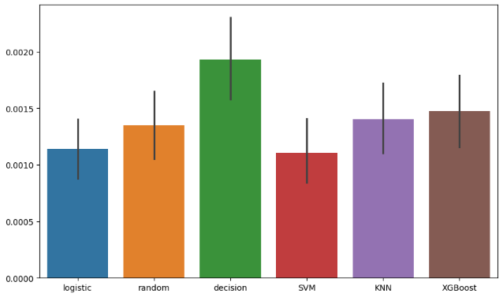
All Model Comparison

Slide 20
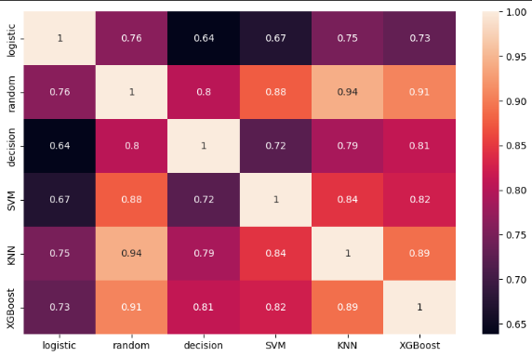

Slide 21
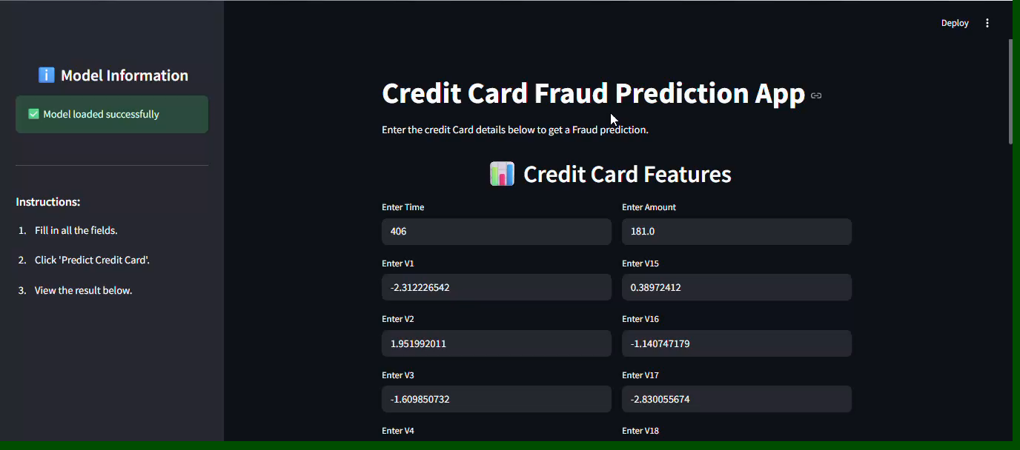
Deployment

Slide 22
THANK YOU

